Slide 1

Slide A
Material Structures and Properties
Turn and Talk
What did we learn about the shape, thickness, or properties of protective materials we should be using in our designs?
Be prepared to share your ideas with the whole class.
Notes:
Recall previous learning. Display slide A.
Say, Think back to last class. What did we learn about the role of shape, thickness, or properties of protective materials that we should be using in our designs?
Give students time to turn and talk with a partner about the prompt on slide A. After a moment, ask students to share their ideas with the whole group. As students are sharing, listen for the following ideas to be discussed:
Protective materials should have space (or air) for the solid materials to deform into.
Protective materials should deform a lot when relatively weak contact forces are applied to them.
The outer surface of those materials should be placed in an area where they will make contact with the damaging, colliding object.
The inner surface of those materials should make contact with as large an area as possible on the parts of the body or object they are protecting.
The thicker the protective material is (not always more dense), the more it will reduce peak forces.
If these ideas are not mentioned, ask students to look back at their diagrams from Lessons 12 and 13. Ask students what they notice about the materials that are contributing to a reduction in the peak forces on the object they are protecting.
Say, It seems like we have learned a lot about the properties and structures of protective materials! Let’s see if we can apply this to optimize our designs.

Slide 2

Slide B
Revising Designs
On Your Own
Let’s spend some time revising our designs using our protective material science ideas.
We will redraft our designs on a new handout.
After that, we will have the opportunity to think about the specific changes we are proposing and why we are making those changes.
Notes:
Introduce Redesigning Your Protective Device. Display slide B. Instruct students to get out their handout Drafting Our Protection Device Design from Lesson 11. Explain that students will get a chance at revising their old design from Lesson 11 to reflect the current understanding of materials and how they help reduce peak forces in a collision. Using a fresh, new handout to record their protective device redesign will allow students to keep a record of their first iteration of their designs as they draft their new ideas. Distribute Redesigning Your Protective Device to students and go over it with them. Begin by pointing out the box where students will be drafting their redesigned protective devices. Make sure that students know they will be redrawing their ideas in this box, using their old designs on Drafting Our Protection Device Design as a starting point. Direct students to then look at the table on the next page. Explain that this table will walk students through considering what changes they are making and why. Column 1 asks students to list the changes that are being made, column 2 asks students to give their reasoning for the changes based upon their science ideas, and column 3 asks students to think about what effects those changes will have upon their system. Because this chart is new, tell students that we will do an example together based upon a design to protect a car side mirror in a parking lot.

Slide 3

Slide C
Whole Class Example
Revising Designs
Whole-Class Example
Change I have made to my protective device | The scientific reasoning behind the change I have made | Effects of that change on the performance or structure of the device (positives or negatives)
Notes:
Display slide C. Point out that the chart on the slide is a copy of the chart on their handouts.
Say, Imagine that I had designed a protective device to put onto the side mirrors of my car when I am parked in a parking lot to avoid scratches and bumps. Originally I had made a design that was a box of wood because I thought it would be really sturdy, but I didn’t think about the energy transferring through the wood. Now I have changed my design to be made of the same foam as earplugs.

Slide 4
Slide D
Revising Designs
Whole-Class Example
Change I have made to my protective device | The scientific reasoning behind the change I have made | Effects of that change on the performance or structure of the device (positives or negatives)
I changed my material from wood to earplug foam.
Notes:
Display slide D. Point out to students how the change is documented in the first column.
Say, Now I need to think about how I can justify this change using my science ideas. I made the change from wood to foam because foam deforms more and can be shaped to spread the impact out over a larger area when it is being deformed. The wood would get bumped and then would just bump right back into my mirror!

Slide 5
Slide E
Revising Designs
Whole-Class Example
Change I have made to my protective device | The scientific reasoning behind the change I have made | Effects of that change on the performance or structure of the device (positives or negatives)
I changed my material from wood to earplug foam.
Foam deforms more and can be shaped to spread out the contact force over a greater area.
Notes:
Display slide E. Point out to students how this rationale is documented in the second column of the chart.
Say, Finally, I have to think about the change on the overall structure of the device. There are positive and negative effects that would happen if I use foam as my main material instead of wood. I like the idea of foam better, but I think that making it out of foam will have an effect on how durable it is. I decreased how durable my design is since the wood would definitely hold up better over time. Also, foam just can’t be nailed together like wood. Because it needs special glue or something to create, it will also be a lot harder or take more time to create and sell. On the other hand, the foam will be easier to store since it can deform and probably fit under a seat in the car.

Slide 6
Slide F
Revising Designs
Whole-Class Example
Change I have made to my protective device | The scientific reasoning behind the change I have made | Effects of that change on the performance or structure of the device (positives or negatives)
I changed my material from wood to earplug foam.
Foam deforms more and can be shaped to spread out the contact force over a greater area.
Foam is less durable and may not last as long. Foam is harder to work with but easier to store.
Notes:
Display slide F. Direct students to look at the documentation of these ideas in the third column.
Tell students that they will be given time to work on this redesign. Explain that if students have made more than 3 major changes to their designs to focus the chart on the biggest changes made based upon their science ideas. Give students 10 minutes to work on their own to complete Redesigning Your Protective Device.
Bring the class back together. Display the Whole-Class Criteria and Constraints chart from Lesson 11. Recap that up until this point our designs have focused on what materials will best help our designs protect our objects. We have spent some time learning about the materials’ properties and thinking about how best to meet those criteria. Point out that while we have done a great job addressing what we mean by good shapes and protective materials and incorporating our science ideas into our design, we also said that we have constraints to consider.
Say, When we started to design our devices, we created a Criteria and Constraints chart. Other than our criteria, what else did we say we needed to consider as a class?
Allow students time to share out the items in the ”Constraints” column. If students would like to add more constraints than currently listed on the chart, add those to the chart at this time.
Continue discussing the constraints list with students. Determine that different devices will have different constraints depending on the use of the object being protected and that all constraints may not be met perfectly for the practical use of the device. Example prompts and responses are located in the teacher guide.
Say, It’s interesting that device designers seem to have to make the best decisions based upon the need and considerations of those that the device affects. It also sounds like some considerations are more important than others in most designs, and sometimes compromises need to be made. Do you think that a professionally designed item would also have some of these compromises in its design? Let’s take a look at a common protection device together to see if actual engineers have had to make the same kinds of decisions.

Slide 7

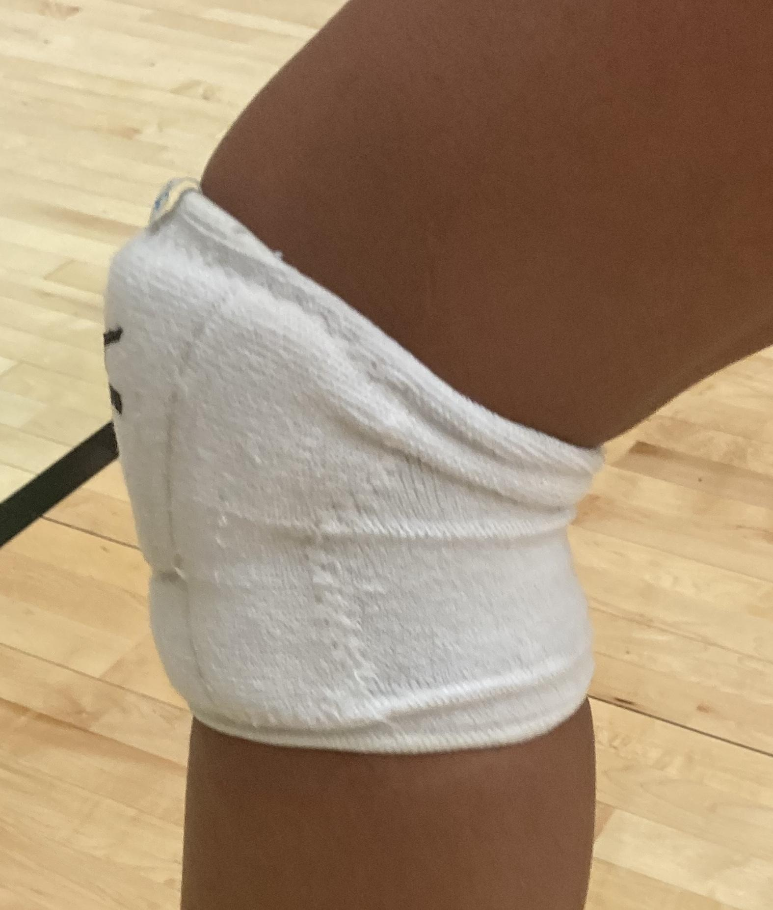
Slide G
Discuss Trade-offs
Turn and Talk
Take a look at this kneepad design to the right.
What are some constraints that would apply to this protective device?
Are there any constraints that the design would have that are more important than others?
Be prepared to share your ideas with the whole class.
Notes:
Discuss trade-offs with knee pads. Display slide G. Ask students to turn and talk about the questions on slide G.
What are some constraints that would apply to this protective device?
Are there any constraints that the design would have that are more important than others?
Ask students to share their ideas with the class. Students should identify the constraints of size, cost, type of material used, shape, ease of use, reusability, and others as considerations that a designer would have to keep in mind when creating this device.
Discuss trade-offs. Remind students that we learned about trade-offs in the Tsunami Unit and Homemade Heater Unit. Trade-offs are when criteria or constraints have to be weighed against each other to make an informed decision. When designers of these devices are weighing the options and the relative importance of criteria or constraints, they are making trade-offs. Ask students about the trade-offs made during the designing of the kneepad. Example prompts and responses are located in the teacher guide.
Say, It seems that these trade-offs you are mentioning are very purposeful. It appears the designer really thought about the effects each change would have on the device and what would be important for safety but also user friendly at the same time. They had to make choices that they felt optimized the design but stayed within the limits of the device.

Slide 8
Slide H
Getting Design Feedback from Others
Turn and Talk
If we were to think about trade-offs for our devices, who would we need to consult to make sure we were making an informed decision about what was important?
Why would we need to consult and consider the feedback of others in the first place?
Be prepared to share your ideas with the whole class.
Notes:
Consider sources of feedback. Project slide H. Have students turn and talk with a partner about the prompts on the slide.
If we were to think about trade-offs for our devices, who would we need to consult to make sure we were making an informed decision about what was important?
Why would we need to consult and consider the feedback of others in the first place?
Ask students to share their ideas about the first question with the class. Students should identify the following people:
the people who know the science behind the design
those who will use the design
those who will benefit from the design
those who are impacted by the design
Ask students why we would need to consider feedback from others in the first place. Students should respond that without their feedback it may not meet their needs and people may not buy the design.
Say, OK. We have done a great job learning about the science behind our designs, but if we are going to make our devices better, we need input from people who will use the designs, benefit from the designs, or be impacted by the designs. This group of people is referred to as stakeholders. We need to consult at least some of our stakeholders.
Remind students that in the Tsunami Unit we learned about stakeholders. Stakeholders are the people who have interest in or concern for something. As we redesign our protective devices, our stakeholders will be the ones who would eventually use and/or purchase the devices. We could make the safest design in the world, but if our stakeholders would not purchase it or use it, then the design is useless. Stakeholder feedback will be needed and very important to the design of our protective devices.
Prepare stakeholder feedback form. Explain to students that we have a form to use that will help us get feedback from stakeholders. The form is set up to ask the stakeholder questions based upon the design type and will help get targeted feedback to help optimize the design.
Explain to students that sometimes when we think about giving feedback on designs, we limit our thinking to just critiquing a specific design and the choices made in that specific design instead of considering the possibilities of what could be created if a totally new, never-before-seen design was being made. To make sure we don’t limit our feedback, we will first need to get ideas from stakeholders about our potential designs without the stakeholders being influenced by our designs.
Tell students that this can be done by either discussing designs that are already in use or by asking stakeholders generally what they would like to see in that kind of protective device design. This way students will be able to figure out what considerations are truly important to them without stakeholders feeling that they are being critical of the student’s design. After that, we can then introduce our design and get more-targeted feedback on our design and trade-offs.
Distribute Stakeholder Feedback Form. Start by pointing out the two different parts to the handout. Part 1 is all about preparing and organizing our ideas to share with our stakeholders. Part 2 will be where we record the feedback from our stakeholders. Tell students that we will be going through part 1 together, and part 2 will be home learning.

Slide 9
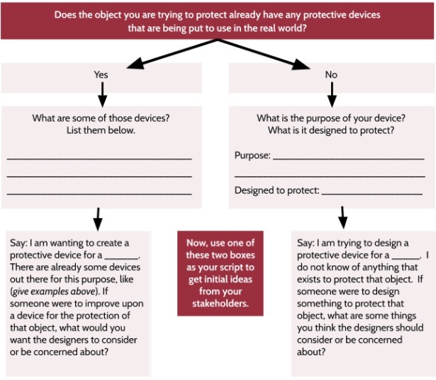
Slide I
Eliciting Feedback
Feedback Form, Step 1
Notes:
Introduce the decision tree. Project slide I. Explain that step 1 will help us know what to say to our stakeholders depending on our type of device. Walk through the decision tree in step 1, pointing out the two different columns on the slide that correspond with the columns on the handout.
Say, Look at your design on Redesigning Your Protective Device. If you have designed a protective device that you think improves upon existing designs, like making an improved cell phone case, you will use the prompts in the first column. If you are creating a novel design for an object and there is no current protective device already available, use the prompts in column two. Let’s use some time right now to complete the column that applies to your design.
Give students time to complete the column that is applicable to their design. Circulate and verify that students are using the correct column for their design.

Slide 10
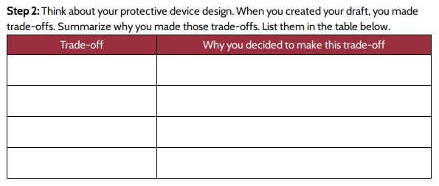
Slide J
Eliciting Feedback
Feedback Form, Step 2
Notes:
Explain step 2. Project slide J. Next, direct students to step 2 on their handout. Explain that the table will help students think about their design trade-offs and organize them so they can more-easily share their design decisions with their stakeholder. In the first column students will list the trade-offs used in their design. In the second column, students will give the rationale for the trade-off choices. Explain that the rationale is important to share with the stakeholder since a quick viewing of the device design may not allow the stakeholder time to consider the impact of trade-offs associated with certain design decisions.
Go over the home learning with students. After explaining the table, move on to the home learning portion of the handout. Point out that step 3 is going to have students use the script identified in step 1 when discussing potential designs with their stakeholder. In part 2 students will get ideas from the stakeholders before sharing their design. Tell students that it is OK if they want to ask more than one stakeholder, and if they run out of room they can write on an additional piece of paper or in the margins of this home learning handout.
On step 4, explain that students will use the trade-off table they will complete in step 2. They will share their decisions with their stakeholder and ask their stakeholder if they have any additional considerations or ideas. They will document those ideas in the table below step 4.
Finally, step 5 is asking the stakeholder to do a review of the product. Tell students that it is OK to give the paper to the stakeholder for them to record their review. Students should make sure to let the stakeholder know that it is important to be honest so that the review can be used to optimize the design. Remind students that stakeholders are anyone impacted by the design, which means stakeholders can be other teachers, students, neighbors, friends, or even siblings or other family members.
Allow students to work on the trade-offs table in step 2 until the end of the class period. As students are preparing to leave class, remind them to take home both Redesigning Your Protective Device and Stakeholder Feedback Form to get feedback from their stakeholders. They will collect feedback on their design from a stakeholder as their home learning, and the feedback will be used in class next time to consider design revisions.

Slide 11
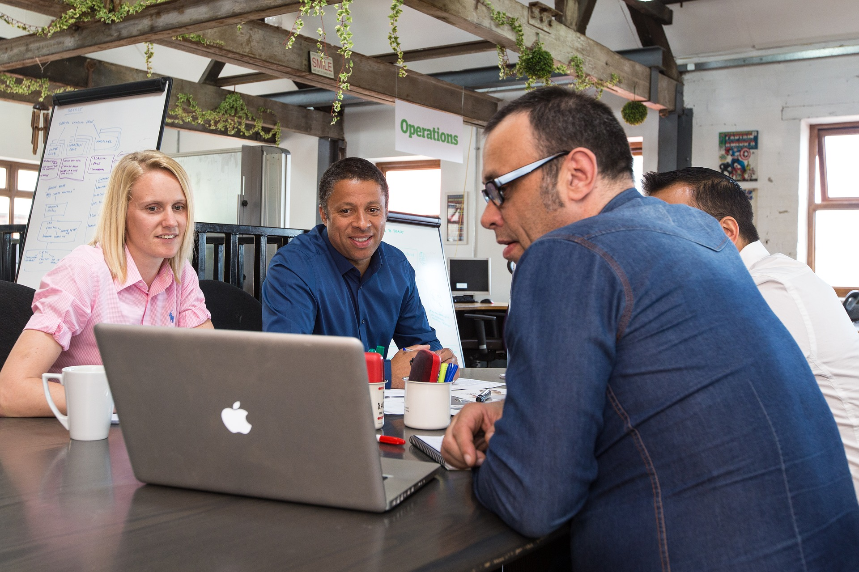
Slide K
Engineer’s Feedback Process
Market Research
When designing a device, engineers get feedback from stakeholders. This process is called market research.
These are some ways that engineers can conduct market research:
using focus groups
reviewing previously collected stakeholder attitudes and ideas
conducting product polls
asking consumers directly
Notes:
Draw parallels to market research. Project slide K. Explain to students that during their home learning they engaged in something real engineers do to get feedback from stakeholders. This is called market research. Companies and designers use different methods such as conducting focus groups, reviewing stakeholder thoughts on existing designs, analyzing stakeholder data from existing designs, and conducting large polls. But they also go and ask the consumers directly, just as students did during their home learning task. Explain that engineers also collaborate to create an optimal design, and the more stakeholder feedback that is received, the better the potential the design has to meet the needs of the stakeholders as a whole. Because of this, we are going to have an opportunity to share our feedback from our stakeholders with someone else in our class.

Slide 12

Slide L
Sharing Feedback
With a Partner
Share your feedback with a partner. Use the questions below to help guide your discussion.
What trade-offs or ideas did your stakeholder give you?
What feedback are you considering and not considering for the redesign of your device? Why?
Notes:
Share stakeholder feedback. Project slide L. Tell students that they can use the prompts on slide L to share their feedback from stakeholders with their partner. If their partner shares some good feedback or a trade-off that they think is important, they should add it to their handout.
Circulate as students are sharing the feedback they received from stakeholders on their devices. Listen to what trade-offs and feedback students were given by stakeholders and what trade-offs students would consider in the revision of their designs. Bring the class back together after the partners share to discuss the trade-offs and feedback shared by the stakeholders.
Say, I heard a lot of different trade-offs that were mentioned by stakeholders, like ___, ____, and ____. It sounds like some of these trade-offs might be useful in our designs, while other pieces of feedback may not be as useful. Now that we have had a chance to talk to our stakeholders, let’s think about the things our stakeholders are prioritizing and determine if those changes would actually help to optimize the design.
Say, Some of our trade-offs or suggestions mentioned by our stakeholders seemed to be practical, like it has to hold up to repeated uses or that it needs to be a certain size. Others, like how the design looks, should be considered too, but we may not think they are as important. We have to remember that to a stakeholder all of their feedback is important, so we need to consider all the feedback and trade-offs. When we think of potential stakeholder criteria such as durability, reusability, environmental friendliness, and protectiveness of our device, we are really evaluating the use of the materials that the design is constructed with.
Explain to students that before engineers build their designs, they take into account the materials. Designing and redesigning prototypes can get expensive, so engineers try to get the majority of the issues resolved on paper before building the prototype. Tell students that in order to make sure we are using the right materials that align with the stakeholders’ feedback, we will get a chance to use a matrix to assess how well each material will potentially work for our designs.

Slide 13
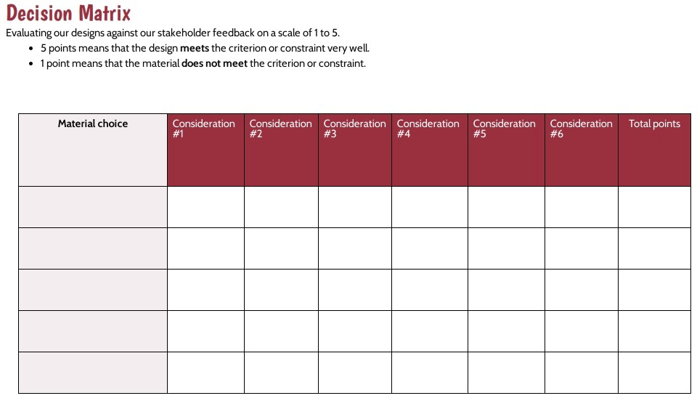
Slide M
Eliciting Feedback
Using Our Decision Matrix
Notes:
Distribute Decision Matrix. Project slide M. Pass out a copy of Decision Matrix to each student. Explain that students will be looking at the materials and considering how well they meet the stakeholder considerations and our science ideas. Students should remember using a matrix to evaluate choices in designs in the Cup Unit, Tsunami Unit, and Homemade Heater Unit. Tell students that we will add to our matrix just like we did in those units and focus on our material choices as we evaluate the trade-offs of each design. Tell students that just like in prior units, we will use the 1-to-5 scale to rate how well each material meets the considerations of the stakeholders, with 5 being the best and 1 being the worst.
Begin by having students look back at their designs on Redesigning Your Protective Device and their feedback on Stakeholder Feedback Form and think about the different materials they are considering for their device. Point out the “Material choice” column on their blank matrix. Have students list these potential materials in that first column.Tell students that we will get to compare and evaluate these materials once we determine our important considerations that we want to use to rate these materials against.
Say, We will be starting with a blank matrix since we all have different objects we are protecting. Part of the matrix will have to be completed on your own, but there are criteria that we can all agree upon. Let’s record that together. What are those criteria?
Elicit responses from students. Students should say that one criterion is that the device needs to be made of materials that are good at protecting our objects. Ask students how we know that a material is protective. Students should respond that the material would reduce peak forces on the object it is protecting. Since students have already spent time exploring and naming the properties a material’s structure has to have to make it protective, explain to them that we will just use the criterion of force reduction on our matrix. Direct students add this to our matrix by writing “force reduction” in the red space under column head “Consideration #1”.
Direct students to think about other considerations that they or their stakeholders thought were important. Ask students to share 2-3 more examples and show them on the slide where those considerations would be added to the matrix. Have students think about considerations specific for their designs and list them under the other ”Consideration” columns on their own handouts.
Say, Now that we have thought a bit about what we want to evaluate for our material choices, we need to start assigning ratings to how well potential design materials meet our needs. Luckily, scientists and engineers have done many tests on the materials we have analyzed so far, and we were able to get some of those data to use in our redesign.

Slide 14
Slide N
Reliability of Data
Reliable Data Sources
Force reduction
Reusable
Robust
Recyclable
Biodegradable
Material cost
Cost to work with the material in a design
Water used for production
Does not contribute to climate change
We have some materials data from researchers at the Michigan State University (MSU) School of Packaging.
They used a Life Cycle Analysis (LCA) program to assess our materials from Lesson 11. They also used research data to compile additional categories.
Notes:
Establish reliability of data. Project slide N. Explain to students that data for commonly used packaging materials were assembled for our use by the Michigan State University School of Packaging. This specific school at Michigan State University is focused on studying (and teaching) all aspects of packaging and packing materials. Researchers who work there took our list of common materials from Lesson 11 and ran the same amount of each material through a Life Cycle Analysis (LCA) program that is used to look at completed package designs. They were able to assess the environmental impacts of each material. The university also used some of their preexisting data on the same amounts of materials to rate each material in the other categories shown.
Explain categories. Go over each category with students. Tell students that if they find a relevant category they should add it to their matrix as a new consideration. The ratings are given as a comparison from one material to another. Below is a description of each category:
Force reduction- how well the material reduces force on an object that it is protecting (The better the score is, the better the device does at reducing peak forces.)
Reusable- It can collide with other objects again and again and still be reused.
Robust- how well the device will work to protect heavy objects in a collision
Recyclable- how easy it is to recycle the material based upon availability of recycling sites for that material
Biodegradable- how well the material will biodegrade when thrown out
Low material cost- how cheap the material is for the same size sample
Low cost to work with the material in a design- how inexpensive it is to pay a worker to use that material to create a design solution
Water used for production- how much water goes into the creation of that material
Does not contribute to climate change- how small of an impact the creation of the material has on climate change
Ask students to copy any relevant considerations that they would like to use from this list onto their matrix.

Slide 15
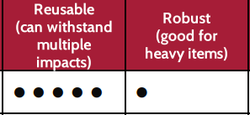
Slide O
Understanding Data
Our 5-Point Scale
We will be using a 5-point scale, just as we used in our Natural Hazards unit.
5 points means that the design meets the criterion or constraint very well.
1 point means that the material does not meet the criterion or constraint.
This material is incredibly reusable and could withstand multiple impacts.
This material is not robust at all. It could not protect a heavy item.
Notes:
Present data for student analysis. Project slide O. Distribute Additional Material Considerations Matrix to students. Show students the 5-point rating scale that has been used, which matches rating scales used in previous units. Remind students once again that to have a rating of 5 means that it works well with that consideration. A rating of 1 means that it does not work well with that consideration.

Slide 16
Slide P
Using Data to Analyze Material Choices
Transferring Ratings to Our Matrix
Look at your chosen considerations for each material.
Spend some time transferring over the consideration ratings from the MSU matrix to your decision matrix for those materials.
If the material does not exist on the MSU sheet, think about how the material would meet the considerations compared to the current analyzed rankings.
If you have to create your own rating, ask a partner to check your newly developed rating to see that it makes sense compared to the other materials and considerations.
Notes:
Transfer data to the Decision Matrix. Project slide P. Tell students that in a moment they will transfer only the data that apply to their materials and design from Additional Material Considerations Matrix to Decision Matrix. Remind students that the ratings were done comparatively, so the materials were compared to each other to create those ratings. If students are going to consider materials not on Additional Material Considerations Matrix, have them think about how well the material would do compared to the others for each consideration and assign it a fair rating on the scale of 1-5. Tell students they can ask a partner to help verify any newly developed ratings as they are transferring the data to the Decision Matrix. Allow students time to transfer and develop ratings.

Slide 17
Slide Q
Using Data to Analyze Material Choices
Turn and Talk
Use your “Total points” column to total up the ratings for the materials in your particular design.
If we were to look at the ratings and select the best material based upon which material has the highest overall rating, would that be the best material for the design? Why or why not?
Be prepared to share your ideas with the whole class.
Notes:
Establish a need for ranking criteria. Once students have had a chance to fill in the data on the matrix, bring them back together as a class. Project slide Q. Have students turn and talk with a partner about the question on the slide.
Use your Total points” column to total up the ratings for your particular design.
If we were to look at the ratings and select the best material based upon which material has the highest overall rating, would that be the best material for the design? Why or why not?
Say, OK, now we have all our important data and considerations rated together on one page. If we were to just go across the chart and look at the material with the highest total points, would that material be the best for the design? Why or why not?
Review primary and secondary considerations. Allow students to respond. Students will mention that while some materials are rated lower in force reduction, the other considerations bring up the overall score. Remind students that in Tsunami Unit we determined that some considerations were more important than others. We reviewed our criteria and constraints and labeled the most important considerations as primary and the others as secondary.
Ask students, If we were to establish a consideration across all materials that was the most important, what would it be?
Students should respond that the primary goal of reducing peak forces on the object would be the primary consideration. Have all students put the letter “P” for primary above the ”Force reduction” column.
Ask students if there are other considerations that are still important to the functionality of the device, but may not be a primary consideration. Allow students to give a couple of examples of these considerations, such as the consideration of reusability.
Remind students that in the past we have used the secondary consideration designation for these criteria and constraints. Explain to students that we will label the consideration columns that fall into this category with the letter “S” as secondary considerations.

Slide 18

Slide R
Establishing Consideration Rankings
Primary, Secondary, and Tertiary Considerations
Use the rankings below to help guide you as you classify your considerations as primary, secondary, or tertiary. Write “P”, “S”, or “T” above each “Consideration” column.
Primary considerations - the most important considerations for our designs
Secondary considerations - the considerations that are still important, but we have more flexibility meeting
Tertiary considerations - the considerations that are the least important to the overall design but may still be seen as important to some stakeholders
Notes:
Introduce tertiary considerations. Project slide R. Say, Since we are working with stakeholder input, all of the input is valuable. But, we also know that some input is more valuable than others. Some stakeholder considerations are based around the actual function of the device, and some may be superficial. Because of this, we will be adding a third level of classification called tertiary considerations.
Explain that this third level of classification falls below the rank of secondary considerations. It will be the least important of our considerations when working with a material. Tell students that now that we have an established prioritization system, we will start assigning our considerations as primary, secondary, or tertiary.
Determine primary criteria. Ask students to look at their charts on Decision Matrix and start by determining what should be considered primary criteria and label the space above these columns with the letter “P”. Remind students that the primary considerations are the most important items to the stakeholders.
Determine secondary and tertiary criteria. After establishing primary considerations, students should look at the remaining considerations and determine if they are of more or less importance. If any considerations are deemed to be of a higher importance, but not quite primary criteria, students should label the space above these secondary criteria with the letter “S”. All other criteria should be labeled tertiary criteria with the letter “T” in the space above their corresponding columns.

Slide 19
Slide S
Interrater Reliability
With a Partner
When engineers and other scientists have to rate objects or data, they call the process establishing interrater reliability. Let’s engage as scientists in checking our ratings with a partner. Follow the guidance below as you work with your partner to assess interrater reliability.
Have a partner look at your ratings and see if they agree with your ratings. If they agree, keep the rating the same. If they do not agree, discuss why each of you would give a different rating. If needed, ask a third person to weigh in. Try to come to a consensus.
Give your partner feedback on any changes you would make to their ratings with your reasoning.
Notes:
Check criteria rankings with a partner. Display slide S. Ask students to share their labeling of primary, secondary, and tertiary criteria with a partner. Tell students that engineers also do this, and it is referred to as checking for interrater reliability. Students should give their partner feedback orally using the prompts on slide S. Students should adjust their rankings as needed based upon the feedback from their partner.
Compare overall scores of materials. Alter point values based upon rankings. Discuss ways to elevate the primary criteria and constraints with students. Example prompts and responses can be found in the teacher guide.

Slide 20
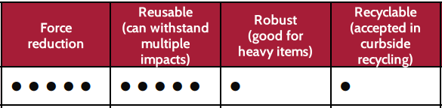
Slide T
Weighting Scores
Adjusting Our Scores to Reflect Ratings
Look at your scores and multiply them based upon your ratings of primary, secondary, and tertiary.
  Primary criteria - multiply the rating by 3
  Secondary criteria - multiply the rating by 2
  Tertiary criteria - rating stays the same
Add up the ratings for each material after you have done the multiplication.
P
S
T
S
12
old
score
5 x 3=15
5 x 2=10
1
1 x 2=2
15
+
10
+
1
+
2
=
28
new score
Notes:
Project slide T. Allow students time to do the multiplication involved with weighting the scores and then the addition in totalling up the new material score. If some students struggle with how to do this multiplication, use the example on slide T to walk them through this process of weighting the criteria, multiplying based upon the rating, and then adding up the total new points for each material.

Slide 21
Slide U
Weighting Scores
With a Partner
Look at your adjusted total scores. Do these scores seem to better reflect what stakeholders value?
Do you think that these scores are more accurate? Why or why not?
Do you feel that these new scores are more useful?
Be prepared to share your ideas with the whole class.
Notes:
Reflect on weighted scores. Project slide U. Have students compare pre vs. post weighted scores with a partner using the prompts on slide U. After students have had a chance to share, bring the class back together. Ask students if they believe these scores are more reliable.
Some students may respond that these scores are more reflective of what the design needs to do, and some will be able to see a change in the highest rated material for their design. Others may point out that there are some criteria that should be “gating” criteria, that if they do not meet that criteria they should be automatically eliminated (they don’t make it through the gate to the next round of consideration). Verify for students that this process involves a lot of trade-offs from one aspect to another, and all criteria may not be met perfectly. But, by looking at the different considerations from a stakeholder’s point of view we learn how to make the designs work for the consumers.
Consider design optimization consequences. Say, Let’s think about some of these trade-offs we are now considering with the use of certain materials. It is clear from our different ratings that certain changes and decisions have unintended consequences. By elevating certain criteria, we may be discounting something else important to the stakeholder, or by only looking at the total scores we may miss something else that is more important to the overall rankings. Let’s spend some time reflecting on these choices that we would like to make to optimize our designs.

Slide 22
Considering Trade-off Consequences
Slide V
In Your Notebook
Record the chart to the right in your notebook. As you are filling out the chart, think about the effects of the choices that have been made and how they affect stakeholders and the structure.
My material and design choices | Effects these changes have on other stakeholder considerations | Effects on structure and function of design
Notes:
Display slide V. Remind students that in the Homemade Heater Unit they worked with identifying what consequences their choices would have on the design and how that might affect stakeholders. Tell students that we will be working with a modified version of this activity to consider the implications of our trade-offs and prioritizing of considerations.
Instruct students to create the chart on the slide on the next clean page in their notebook. Explain that in the first column students will write their different decisions that they have made regarding their materials and design, according to their most recent matrix exercise. In the second column, students will consider what affects these changes will have on other stakeholder concerns or input, and in the third column students will consider what affects this design decision would have on the overall design of the device. Give students time to complete this trade-off and prioritization reflection on their own.
Say, We have done a lot of work to ensure we are making informed choices for our designs. Now that we have some great ideas for how to improve our designs for our stakeholders, let’s take some time at the start of our next lesson to synthesize all the data and trade-offs. We can then craft an argument to support our design for marketing purposes. We will also use our science ideas to evaluate some new protective designs!

